Slide 1

Adding Diversity To Vibe Trend (VT)
Desmond Hughes
June 27, 2022
MT140: Introduction to Management

Slide 2
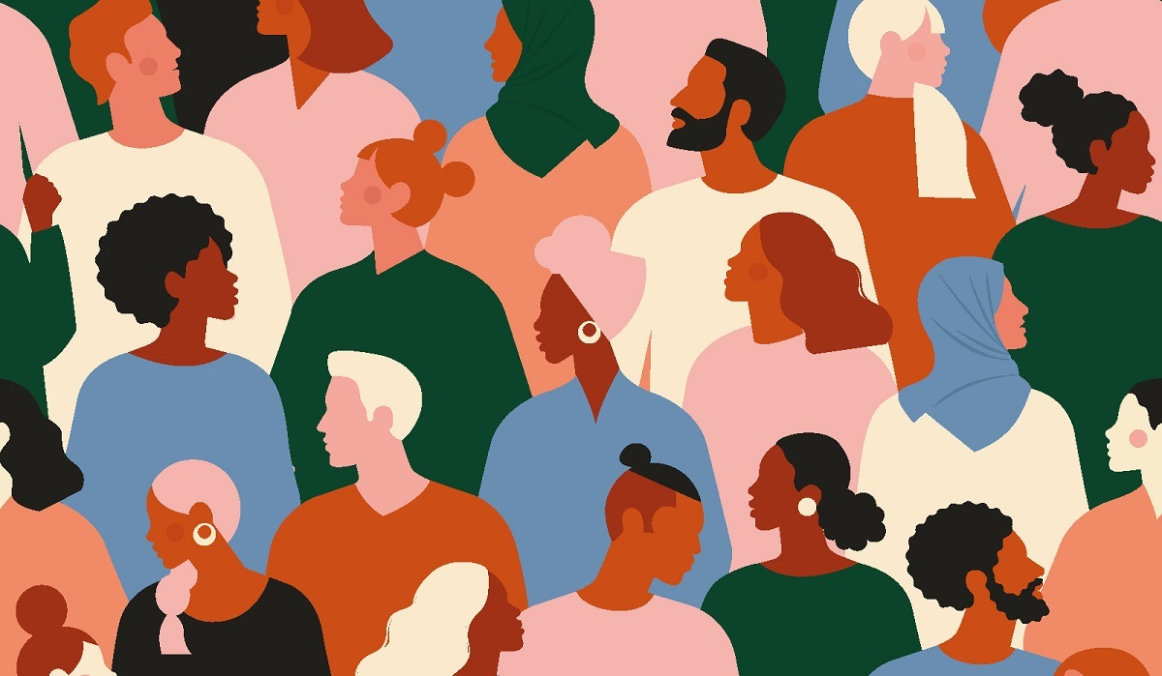
What is Diversity
Diverse to me is being different and having a variety of types and styles of a certain thing, whether it is based on your background, culture, and even something like music. Diversity is what a person unique and different. It is important for a company to embrace different cultures so that they can increase their demographic and target audience. An organization can look for help from diverse people and look at their input and value and take that into consideration.
("Workplace Diversity in 2022 | GMO Research", 2022)

Slide 3
How does Diversity & Competitiveness Relate?
Diversity and competitiveness go hand in hand. By being diverse and acknowledging different types of people and groups whether if it’s based on religion, ethnicity, race, gender, economic statuses, etc., can increase your business. It can also help your ideas grow and become more successful.

Slide 4

What are the Implications of Competitiveness & Collaboration?
Competitiveness can improve productivity and motivate businesses to perform and provide better.
Collaboration Is when each business contributes to an interaction to combine both into one and share equal power on decision making.
With competitiveness and collaboration are combine it helps increase sales, and opportunities, and both businesses also help promote each other and increase their popularity.
(Brownlee, 2022)

Slide 5
Creating a Diverse Workforce (1)
A way to created diversity into the workplace is to acknowledge other differences. Whether if it is race, gender, or culture. Doing this will cause awareness for example culture awareness is being aware of people's background and experiences.

Slide 6
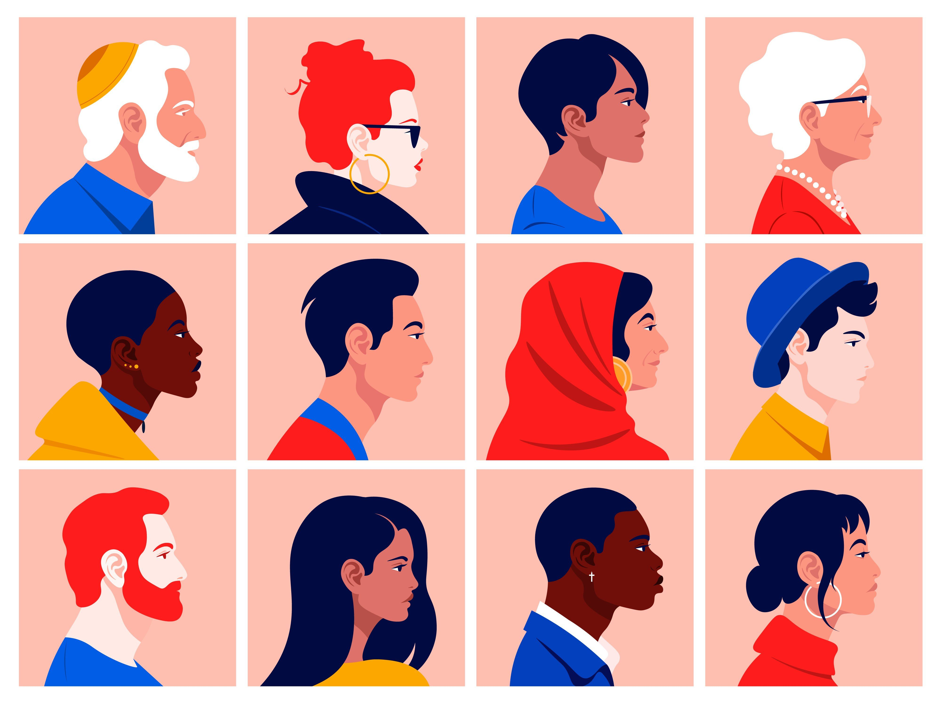
Creating a Diverse Workforce (2)
Hiring more diverse leaders, and/or coworkers can also increase diversity in the workplace. This will create a safe environment for other people that share their differences in the company. Hiring more diverse people can also help with the companies by them sharing different point of views and sharing their voices on opinion.
("Types of Diversity in the Workplace You Need to Know", 2022)

Slide 7
Creating a Diverse Workforce (3)
Creating a safe space for people’s beliefs is another way to create a diverse workplace. Doing this will help employees open up and feel safe about their personalities, gender, race, and culture etc. Making the employees feel comfort will increase moral, and their attitude. It also shows that the business cares about the people who work for them.
“It encourages employees to be themselves at work and feel proud of who they are.” (Panel, 2021)

Slide 8
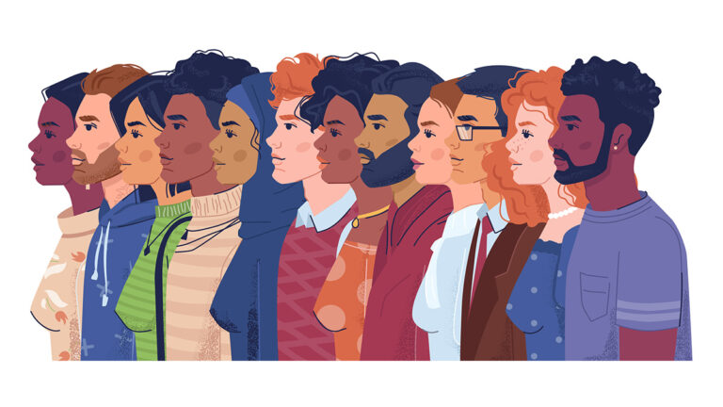
Creating a Diverse Workforce (4)
Keeping an open mind in the workplace can also increase the company's diversity. Maintaining an open mind can be helpful by freeing yourself of what you should expect from people and the assumptions you may have of them. This will lead to giving you more of how others feel and work, which can help your decision making.
("To Drive Diversity and Inclusion, Ask Tough Questions and Listen to Tough Answers - SPONSOR CONTENT FROM SIEMENS ENERGY", 2022)

Slide 9
Creating a Diverse Workforce (5)
Embracing other people's culture can also be a way to be diverse. Celebrating their holidays, by having culture days. They can create activities they can do that is inspired by the culture, which will encourage others to participate in the activities. This will help people learn about the culture and help them stay open minded and learn to respect the culture. Embracing the culture, the company can also be flexible and give them days off for the holiday.

Slide 10
References
Bateman, T. S., Snell, S., & Konopaske, R. (2020). Management. McGraw-Hill Education.
Panel, E. (2021). Council Post: Eight Important Ways To Promote Inclusion And Diversity In Your Workplace. Retrieved 28 June 2022, from https://www.forbes.com/sites/theyec/2021/01/25/eight-important-ways-to-promote-inclusion-and-diversity-in-your-workplace/?sh=271a305b6da1
Pictures:
1 – Workplace Diversity in 2022 | GMO Research. (2022). Retrieved 28 June 2022, from https://gmo-research.com/news-events/articles/workplace-diversity-2022
2 – Brownlee, D. (2022). 4 Common Diversity And Inclusion Myths In The Workplace. Retrieved 28 June 2022, from https://www.forbes.com/sites/danabrownlee/2019/09/22/4-common-diversity-and-inclusion-myths-in-the-workplace/?sh=68ead9cc2052
3 - Types of Diversity in the Workplace You Need to Know. (2022). Retrieved 28 June 2022, from https://builtin.com/diversity-inclusion/types-of-diversity-in-the-workplace
4 – To Drive Diversity and Inclusion, Ask Tough Questions and Listen to Tough Answers - SPONSOR CONTENT FROM SIEMENS ENERGY. (2022). Retrieved 28 June 2022, from https://hbr.org/sponsored/2022/03/to-drive-diversity-and-inclusion-ask-tough-questions-and-listen-to-tough-answers

